Slide 1


Artificial Intelligence Learning Agents Introduction
Artificial Intelligence Training
Created by Andrew Ferlitsch
Instructor October, 2017

Slide 2
Introduction
An agent (e.g., robot) interacts with a dynamic environment.
An agent learns from interacting with the environment
the best actions to take.
Four Types of Agents (in increasing capability):
Simple Reflex agents
Model-based agents
Goal-based agents
Utility-based agents

Slide 3
Simple Reflex Agent
A simple reflex agent always executes the same action for the same observation.
Current State of the Agent
relative to the environment.
Senses the environment (e.g., camera, audio, LIDAR, GPS, ultrasonic)
Simple Reflex Agent
Environment
Sensors
Room, Street, Warehouse, etc.
State
A set of pre-defined rules that map a state to an action.
Rules
Actions
Actuators
Actions the Agent
can take.
Modifies the environment (e.g., walk, pickup, drive)
Works in Environments that are fully observable.

Slide 4
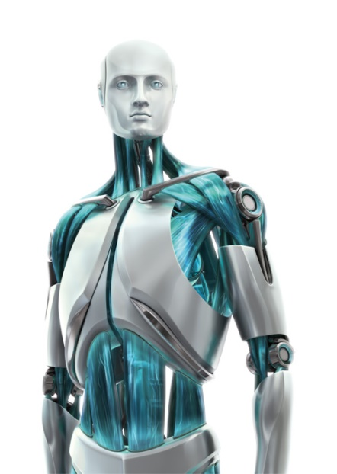

Actions / Environment (Simple Reflex)
Reflex Agent
Preprogrammed
Rules
State
How the action effected the agent and environment.
Continuous Cycle: Observe Environment,
Take Action,
Observe Environment, Take Action
Actions are determined
based on predefined
rules.
Action
Observation
Predefined Rules select
Action based on predicted
State.
Environment

Slide 5
Model-Based (Reflex) Agent
A model-based agent uses model to predict the unobserved portion of the environment.
Presumed State of the Agent
relative to the environment.
Senses the environment (e.g., camera, audio, LIDAR, GPS, ultrasonic)
Model of how the
environment responds
to predict unobserved
changes to the
Environments.
Model-Based Reflex Agent
Environment
Model
Sensors
Room, Street, Warehouse, etc.
Short-term memory
of past observations.
Past
State
A set of pre-defined rules that map a state to an action.
Rules
Actions
Actuators
Actions the Agent
can take.
Modifies the environment (e.g., walk, pickup, drive)
Works in Environments that are only partially observable.

Slide 6
Actions / Environment (Model-Based)
History of Past Observations
Model-based Reflex Agent
Preprogrammed
MODEL
Past
State
How the action effected the agent and environment.
Rules
Predefined Model of
how the environment
behaves.
The model
combines the past and
present observations
to predict the state of
the environment.
Action
Observation
Predefined Rules select
Action based on predicted
State.
Environment

Slide 7
Goal-Based Agent
A goal-based agent uses a goal(s) to evaluate how close to achieving the goal is the next possible action.
(Presumed/Known) State of the Agent
relative to the environment.
Senses the environment (e.g., camera, audio, LIDAR, GPS, ultrasonic)
Goal-Based Agent
Environment
Optional
Model of how the
environment responds
to predict unobserved
changes to the
Environments.
Model
Sensors
Room, Street, Warehouse, etc.
Past
State
A set of pre-defined rules that map a state to an action.
Rules
Actions
A goal(s) to achieve,
when evaluating the
next action (i.e., how
closer to achieving the
goal).
Goal
Actuators
Actions the Agent
can take.
Modifies the environment (e.g., walk, pickup, drive)
Works in Environments which need to predict the future.

Slide 8
Actions / Environment (Goal-Based)
History of Past Observations
Goal-based Agent
MODEL
Past
State
How the action effected the agent and environment.
Rules
GOAL(s)
Predefined Model of how the environment
behaves.
Action
Observation
A Goal(s) for
evaluating how
close is an action/state to
the goal.
Predefined Rules select
Action based on how close is
the predicted State to the goal.
Environment

Slide 9
Utility-Based (“Rational”) Agent
A utility-based agent uses a utility to measure the value of the next possible action to achieving the goal.
(Presumed/Known) State of the Agent
relative to the environment.
Senses the environment (e.g., camera, audio, LIDAR, GPS, ultrasonic)
Utility-Based Agent
Environment
Optional
Model of how the
environment responds
to predict unobserved
changes to the
Environments.
Model
Sensors
Room, Street, Warehouse, etc.
Past
State
A set of pre-defined rules that map a state to an action.
Rules
Actions
A goal(s) to achieve,
when evaluating the
next action (i.e., how
closer to achieving the
goal).
Goal
Actuators
Utility
Modifies the environment (e.g., walk, pickup, drive)
A measurement of
the value of an action
towards the goal.
Actions the Agent
can take.
Works in Environments which must optimize achieving the Goal.

Slide 10

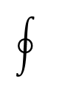
Actions / Environment (Utility-Based)
History of Past Observations
Utility-based Agent
MODEL
Past
State
How the action effected the agent and environment.
Predefined Model of how the environment
behaves.
Rules
GOAL(s)
$$\int{(S,A)}$$
A Goal(s) for
evaluating how
close is an action/state to
the goal.
Action
Observation
A utility for measuring
The value of an State/Action
Towards achieving a goal.
Predefined Rules select
Action based on the value of the
predicted State to achieving the goal.
Environment

Slide 11
What’s Missing?
There is no learning!
Learn the Model (learn to model the environment)
Learn the Utility (learn to measure the value of a state)

Slide 12
Learning (“Intelligent”) Agent
A learning agent dynamically learns a Policy to model the Environment and build Action/State rules.
(Presumed/Known) State of the Agent
relative to the environment.
Senses the environment (e.g., camera, audio, LIDAR, GPS, ultrasonic)
Learning Agent
Environment
A measurement on
how good an action
actually was.
Critic
Sensors
Room, Street, Warehouse, etc.
Policy
State
A learned model of
the environment
and learned State/Action rules.
Actions
A goal(s) to achieve,
when evaluating the
next action (i.e., how
closer to achieving the
goal).
Goal
Actuators
Utility
Modifies the environment (e.g., walk, pickup, drive)
A measurement of
the value of an action
towards the goal.
Actions the Agent
can take.
Works in Environments that are Dynamically Changing (Stochastic)

Slide 13
State / Reward
Intelligent Agent
Reinforcement Learning
Policy
State
Reward
Learned set of
rules of:
States -> Actions
How the action effected the agent and environment.
How positive or
negative is the
new state.
LEARN
Action
Observation
What was
learned from
the reward.
Example Positive Reward: Robot Stands Up,
Closer to Destination
Example Negative Reward: Robot Falls Down,
Further from Destination
Environment

